Slide 1
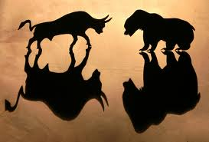
The stock market

Slide 2
Stocks
Stocks: An investment that represents ownership in a company or corporation.
Dow Jones Industrial Average: an index of 30 U.S. stocks used to measure the performance of the U.S. financial markets. “oldest stock price measure and most widely recognized market indicator”
S&P 500: an index of 500 stocks that represent the price trend movements of the major common stock
Stock Index: A basket of stocks used to track the market.
Initial Public Offering: when a company issues stock to the general public for the first time.

Slide 3
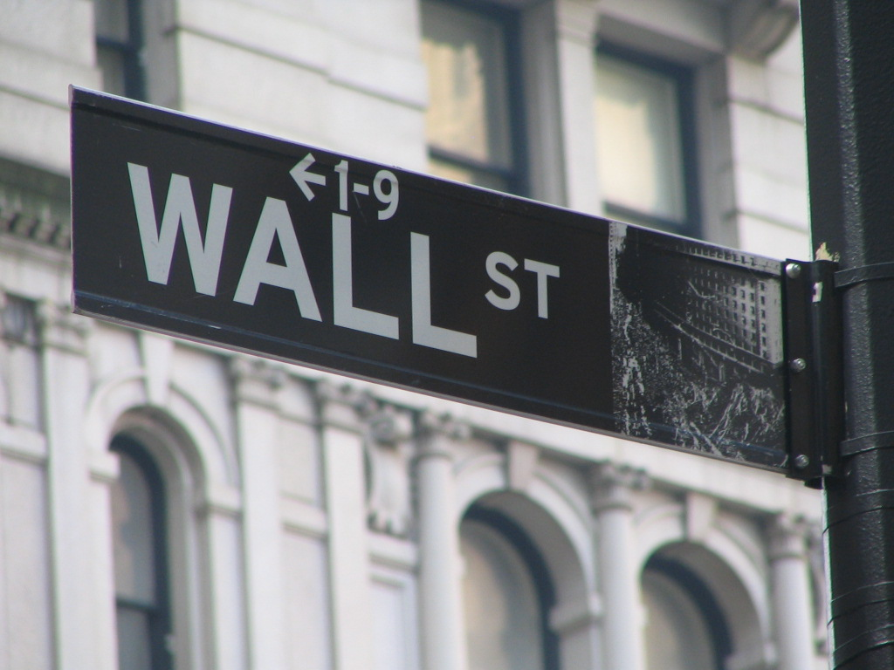
NYSE
Where buyers and sellers of securities meet and compete for the best price for their customers, located on Wall Street in NYC.
Floor Brokers: receive orders electronically on the Trading Floor.
Specialists: Contact point between brokers buying and selling, responsible for overseeing the orderly trading of specific stocks to maintain the market’s fairness, competitiveness, and efficiency.
Each NYSE stock has one specialist who trades only specific stocks at a designated location.

Slide 4
What Drives stock prices?
Auction
I’ve Got It, You Want It
How much I have of any one item and how much you need of that item will affect the price.
Supply & Demand
A stock is worth what somebody is willing to pay for it.
The supply of shares is limited. If one person wants to buy, somebody else has to sell, and vice versa.
A company’s financial health
Market trends
How news affects prices
9/11

Slide 5
Increase/Decrease
Florida in 4-Month Drought
What happens to the stock prices of companies that bottle orange juice?
Battery-Powered Vehicles are Car of Choice
What happens to stock in battery companies?
Hollywood Big Budget, Mega-Movie Flops
What happens to the stock in the company that owns the rights to sell merchandise tied to the film?
True Tech’s Products Compete with Digital Dream’s at 25% Less Cost
What happens to the stock in True Tech? What happens to the stock in Digital Dream?

Slide 6
Trading Floor
Opening bell rings at 9:30 to the closing bell at 4:00
The trading floor is a whirlwind of activity, but it is also an organized, tightly regulated place of business.
Market professionals represent the orders of buyers and sellers to determine prices according to the laws of supply and demand.

Slide 7
Reading Stock Quotes
Notes:
Explain that this is an example of a stock quote, but not all quotes are structured in this same way.

Slide 8
Reading Stock Quotes
Columns 1 & 2
52-Week High and Low – The highest and lowest prices the stock traded over the previous 52 weeks (one year) and typically does not include the previous day’s trading.

Slide 9
Reading Stock Quotes
Column 3
Company Name & Type of Stock – The name of the company. If no special symbol or letter follows the name, it is common stock. Different symbols indicate different classes of shares (i.e., “pf” means preferred stock).

Slide 10
Reading Stock Quotes
Column 4
Ticker Symbol – The unique alphabetic name which identifies the stock. When looking for stock quotes online, you search for a company by the ticker symbol.

Slide 11
Reading Stock Quotes
Column 5
Dividend Per Share – The estimate of the anticipated yearly dividend per share in dollars and cents. If this space is blank, the company does not currently pay out dividends.

Slide 12
Reading Stock Quotes
Column 6
Price/Earnings Ratio – Shows the relationship between a stock’s price and the company’s earnings for the last four quarters. Calculated by dividing the current price per share by the earnings per share.

Slide 13
Reading Stock Quotes
Column 7
Year-to-Date Percentage Change – Reports gain or loss in each stock’s price as a percentage of its price on January 1.

Slide 14
Reading Stock Quotes
Column 8
Trading Volume – The total number of shares traded for the day (in hundreds). Add two zeros to the end of the number listed to get the actual number traded.

Slide 15
Reading Stock Quotes
Columns 9 & 10
Day High and Low – The price range at which the stock has traded throughout the day. These are the maximum and the minimum prices that people have paid for the stock.

Slide 16
Reading Stock Quotes
Column 11
Close – The last trading price recorded when the market closed on the day. If the closing price is up or down more than 5% than the previous day, the entire listing for that stock is bold-faced.

Slide 17
Reading Stock Quotes
Column 12
Net Change – The change in the stock price from the previous day’s closing price in dollars. When the net change is positive, it is recorded as being “up for the day.”

Slide 18
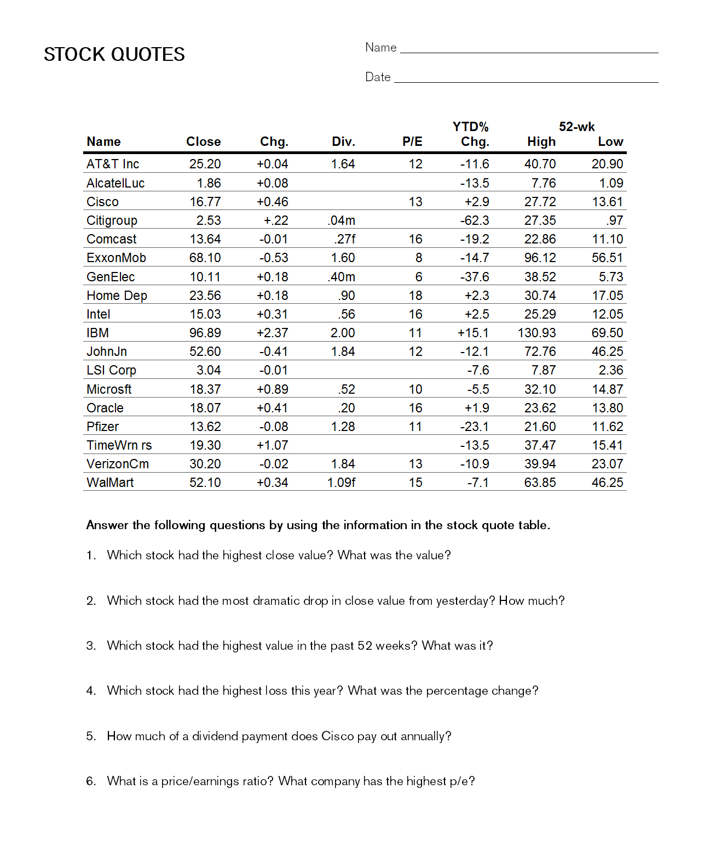

Slide 19
