Slide 1
Check Writing
All About Checks

Slide 2
Check Writing
Checks include the following information:

Slide 3
Check Writing
DATE: Include the month, day and year you are writing the check.

Slide 4
Check Writing
PAYEE: Write the name of the person or business on the line, “Pay to the order of.”

Slide 5
Check Writing
AMOUNT IN NUMBERS: Write the amount of the check in numbers.

Slide 6
Check Writing
AMOUNT IN WORDS: Write the amount of the check in words.

Slide 7
Check Writing
SIGNATURE: Sign all checks the way you sign the signature card.

Slide 8
Check Writing
MEMO: Use the memo area to note the reason for the check.

Slide 9
Check Writing
ROUTING NUMBERS: The nine-digit string of numbers used to identify your bank to process the transaction

Slide 10
Check Writing
ACCOUNT NUMBER: The number used to identify your unique account within the bank.

Slide 11
Check Writing
CHECK NUMBER: The number used to identify a specific check within the sequence of the register. It usually includes 3 or 4 digits.

Slide 12
Check Writing
TRANSIT NUMBER: Used to list checks for deposit.

Slide 13
Check Writing
How to Write Checks: You should fill out the following 6 items.

Slide 14
Check Writing
DATE: Include the month, day and year you are writing the check.
09/15 06

Slide 15
Check Writing
PAYEE: Write the name of the person or business on the line, “Pay to the order of.”
09/15 06
Athletic Shoe Company

Slide 16
Check Writing
AMOUNT IN NUMBERS: Write the amount of the check in numbers.
09/15 06
Athletic Shoe Company
55.63

Slide 17
Check Writing
AMOUNT IN WORDS: Write the amount in words. Start at the left, write any cents as a fraction, and draw a line in the extra space.
09/15 06
Athletic Shoe Company
55.63
Fifty-Five and 63/100 ----------------------------------------------

Slide 18
Check Writing
SIGNATURE: Sign all checks the way you sign the signature card.
09/15 06
Athletic Shoe Company
55.63
Fifty-Five and 63/100 ----------------------------------------------
George Washington Doe

Slide 19
Check Writing
MEMO: Use the memo area to note the reason for the check.
09/15 06
Athletic Shoe Company
55.63
Fifty-Five and 63/100 ----------------------------------------------
Running Shoes
George Washington Doe

Slide 20
Check Writing
How to Cash a Check

Slide 21
How to Cash a Check
BLANK ENDORSEMENT: Sign your name the same way it is written on the front of the check.
Anyone can cash or deposit the check after it’s been signed.
George W. Doe

Slide 22
How to Cash a Check
SPECIAL ENDORSEMENT: Do this when you want to give someone else the money. Write “pay to the order of” and that person’s name. Then sign it. Now that person is the only one that can cash the check.
Pay to the order of
William J. Doe
George W. Doe

Slide 23
How to Cash a Check
RESTRICTIVE: More secure than a blank endorsement. Receiver writes “for deposit only”, and the account number. Then, it can only be deposited into your account.
For Deposit Only
Account # 123456789
George W. Doe

Slide 24
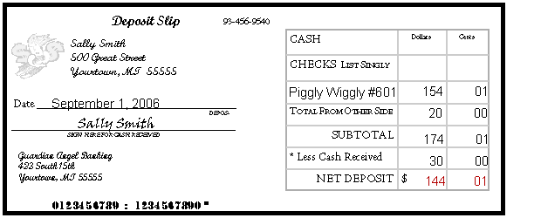
Completing a Deposit Slip
Contains account numbers and allows money to be deposited into the correct account.

Slide 25
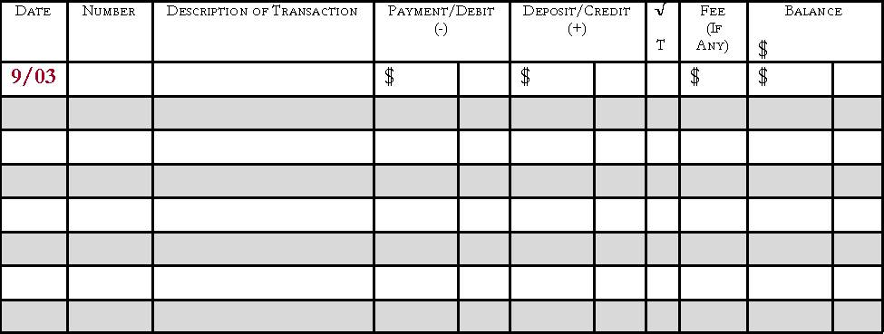
Checking Account Register
Place to record all monetary transaction for a checking account
Deposits, checks, ATM use, debit cards, and bank fees

Slide 26
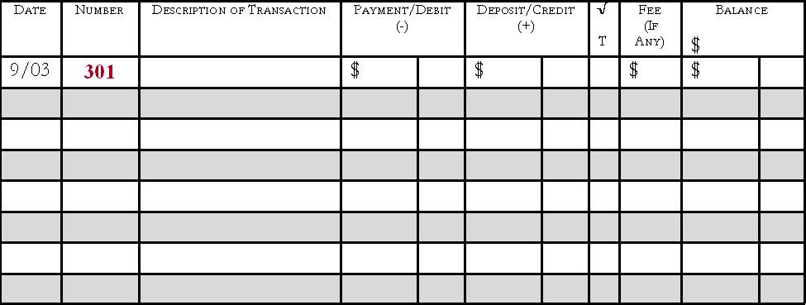
Check Register
Number
The number of the written check; if a debit card or ATM was used, write DC or ATM

Slide 27
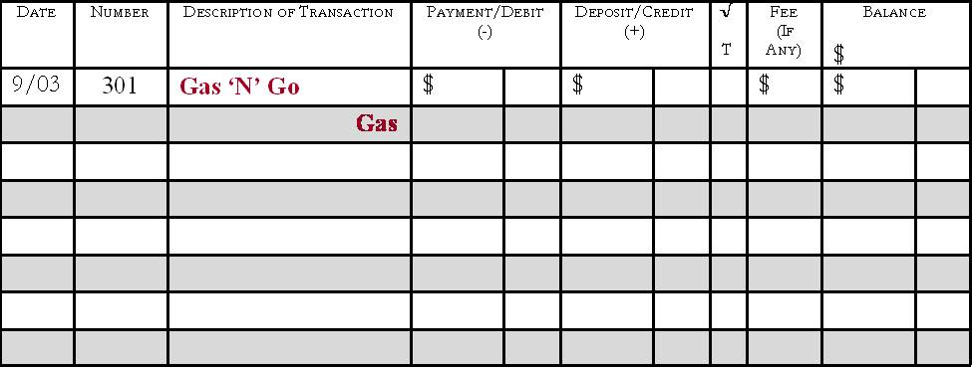
Check Register
Description of Transaction
The person/business the check was written to or where the debit card was used
Gray line can be used to write the memo

Slide 28
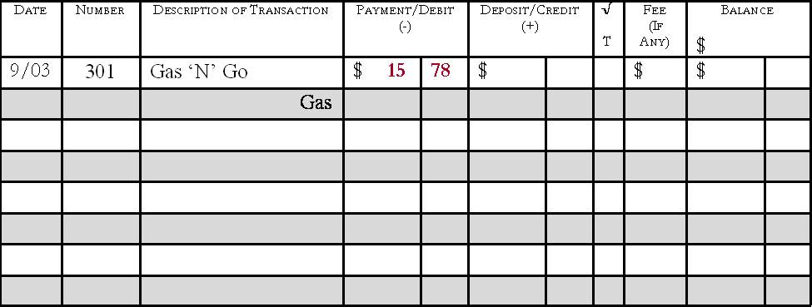
Check Register
Payment/Debit(-)
Amount of the transaction
Deducted from the balance

Slide 29
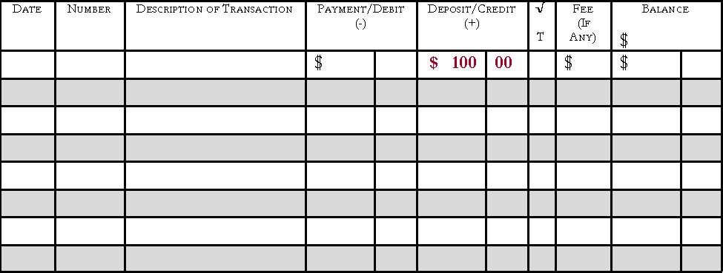
Check Register
Deposit/Credit(+)
Amount of the transaction
Added to the balance

Slide 30
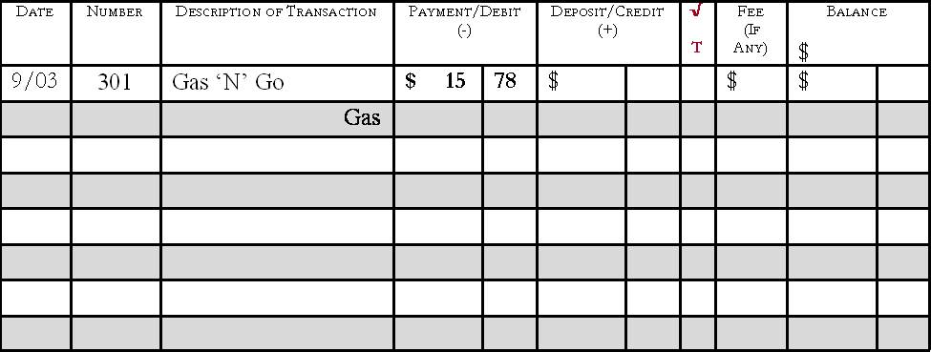
Check Register
√ T
A box used to track whether the check has cleared on the monthly bank statement when reconciling at the end of each month

Slide 31
Check Register
Balance
The running total of the checking account
Calculated by adding or subtracting each transaction
Keep this updated

Slide 32
Reconciling a Checking Account
Reconcile
Balance the checkbook register each month to the balance shown on the statement
Do this every month to ensure the correct balance in the checkbook
Knowing the correct balance can help to avoid bouncing checks

Slide 33
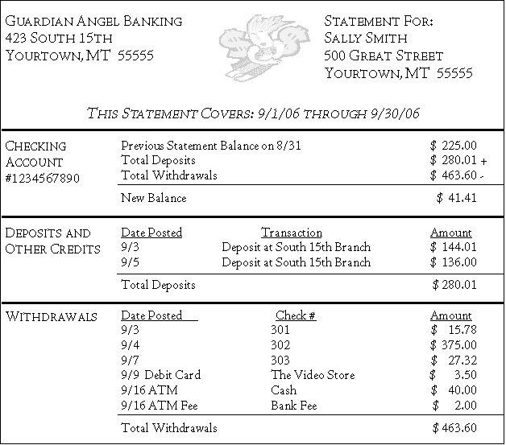
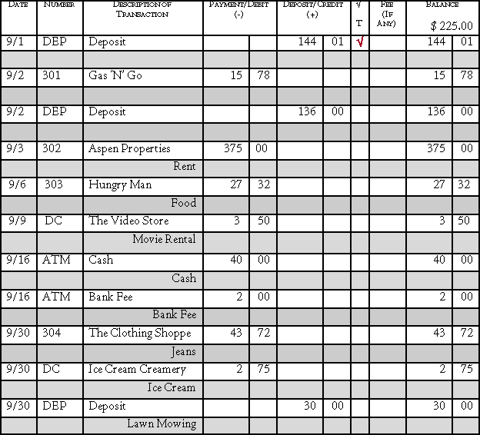
Steps for Reconciling
View the monthly bank statement and check register

Slide 34
Place a check mark in the √ T column for all transactions that have been cleared and are shown on the bank statement
√
√
√
√
√
√
√

Slide 35
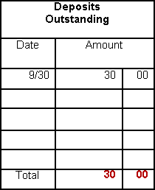
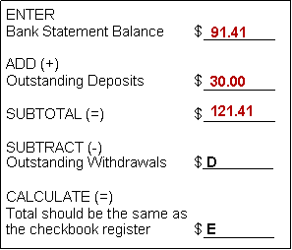
Reconciling your Checking Account
Add any outstanding deposits – transactions that have not cleared the bank
Calculate the Subtotal

Slide 36
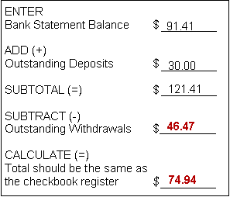
Reconciling your Checking Account
Subtract any outstanding withdrawals and calculate
Compare the total with the checkbook register. If the totals are different, double check the math and make sure all service fees and bank charges are recorded in the check register.

Slide 37
Check Writing
12 Rules About Checking

Slide 38
12 Rules About Checking
1. Only write checks when you have enough money in your account.
2. Write checks legibly.
3. Write the check amount as far to the left as possible.
4. Always use a pen to write checks.

Slide 39
12 Rules About Checking
5. Don’t erase mistakes on a check.
6. Don’t sign blank checks.
7. Use restrictive endorsements.
8. Print the right date on a check.

Slide 40
12 Rules About Checking
9. Always keep checks in a safe place.
10. Destroy voided or unused checks and deposit slips.
11. Record every transaction in the checkbook register.
12. Keep a running balance in the checkbook register.

Slide 41
Check Writing
The End

