Slide 1
INTRO TO EXCEL
Computer Technology

Slide 2
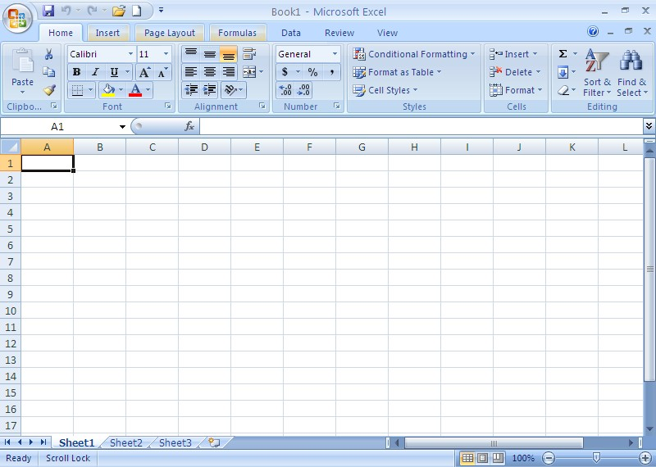

Slide 4
FORMULAS!!

Slide 5
Predefined formulas (mathematical equations) always begin with the equal sign!
=

Slide 6
Formulas
When creating formulas in Excel, you would always use the cell address in the equation!!
 | A | B | C
1
2 | 5 |  | 5
3 |  | 6
4 |  | 4
5
6
7
If you wanted to multiply the 6 by 4 – then you would REALLY multiply cell B3 by cell B4!!
EQUATION :
=B3*B4
What would the equation be if you wanted to multiply 5 by 5?
EQUATION :
=A2*C2

Slide 7
The mathematical operator of multiplication is performed using the operator __________.
*
asterisk
Shift + 8

Slide 8
What would the formula look like when multiplying the cells C6 & D6 together?
=C6*D6

Slide 9
We use the ( + ) to Add!
=D10+E10
We are JUST adding two different cells together?

Slide 10
We use the ( - ) to subtract!
=D9-D7
/=division
Which cell are we subtracting from which?

Slide 11
If you want to do a certain part of the formula first, you enclose it in __________________.
( )
parenthesis

Slide 12
Using the order of operations (algebra) what would the correct answer to the equation be? =22(10*2)
264

Slide 13
Figuring out COST per UNIT
 | A | B | C | D
1 | HOLLINGSWORTH MERCANTILE
2 | Cereal Inventory
3
4 | Types | Units | Cost | Total
5 | Honey Nut Cheerios | 82 | $2.59
6 | Corn Pops | 58 | $1.89
=B5*C5
$212.38
=B6*C6
$109.62

Slide 14
Excel automatically formats numerous types of data to a format that you may not want. To assure that the information you enter into a cell will remain the way you keyed it, key an apostrophe (‘) before the cell contents.
Example ‘May 3
This would be what you would enter into the cell.

Slide 15
In order to find totals – we use addition! The word SUM is used in the equation to signify that you are adding more than one cell together. This is called a FUNCTION.
=SUM(B3:F3)
Type of equation
Cells being added
together

Slide 16
FUNCTIONS
Short cut Formulas!
(fx by Formula bar)

Slide 17
Range of Cells
When referencing a range of cells you use a colon (:) between your first and last cell.
If going from A1 to F17 I would list the range as:
A1:F17

Slide 18
Using Functions to Find:
Minimum Cost
=MIN(B2:B4)
Count Function
=COUNT (B2:B4)
Average Cost
=AVERAGE(B2:B4)
Maximum Cost
=MAX(B2:B4)
Name | Score
Tom | 5
Kyle | 8
Sarah | 7
 | =min(B2:B4)
Name | Score
Tom | 5
Kyle | 8
Sarah | 7
 | =average(B2:B4)
Name | Score
Tom | 5
Kyle | 8
Sarah | 7
 | =max(B2:B4)
Name | Score
Tom | 5
Kyle | 8
Sarah | 7
 | =count(B2:B4)

Slide 19
Showing the Formulas
Ctrl + ~
OR
Formulas Tab / Show Formulas

Slide 20
Absolute Reference
Cells that you don’t want to change as the formula is copied.
$ is used to turn reference from relative to absolute.

Slide 21
CHARTS
Computer Technology

Slide 22
Charts
A chart is often called a GRAPH.
Charts present information in a pictorial format
Charts make it easier to see patterns, trends, & relationships.

Slide 23
Different types of charts
Pie
Line
Bar
Column

Slide 24
PIE CHART
Compares pieces as part of a whole; used for a single series of numbers (data)

Slide 25
LINE CHART
Compares trends over time intervals

Slide 26
BAR CHART
Compares distinct object levels using a horizontal format

Slide 27
COLUMN CHART
Compares distinct object levels using a vertical format.

Slide 28
Example: Make a Wish Fundraiser
Select data we want represented in our chart.
*If we select our headings, they will be labeled in our chart as well.
a) In this example we would select cells A3:C7
2) From the insert tab, select Column Chart

Slide 29
Insert Chart Dialog Box

Slide 30
Example: Column Chart
Chart Title
Vertical Axis
Data Labels
Chart Legend
Gridlines
Axis Titles
Horizontal Axis

Slide 31
Example: Pie Chart
Exploded Piece
Chart Title
Data Labels
Legend

Slide 32
Example: Line Chart

Slide 33
Example: Bar Chart (stacked)

Slide 34
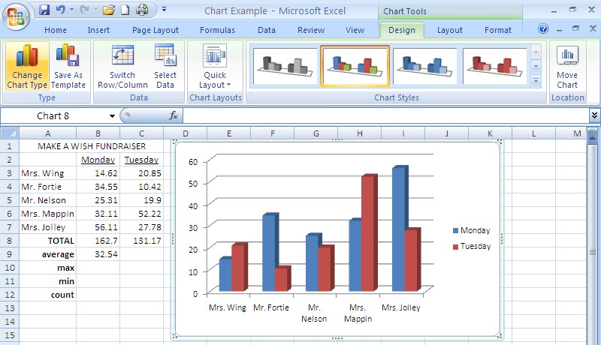
Example:
When you inserted a chart, three new tabs showed up:
Design Tab, Layout Tab, & Format Tab

Slide 35
Design Tab
Has an option to change chart type
Has an option to change chart style

Slide 36
Layout Tab
Has an option to add a chart title
Has an option to add titles to the X and Y axis
Has an option to add & edit the chart legend
Has an option to add data labels or a data table
Has an option to format horizontal & vertical axes
Has an option to format horizontal & vertical gridlines

Slide 37
Format Tab
Has options to change shape fill, outline, & effects of columns

Slide 38
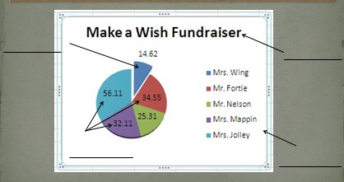
Check your Understanding
List the 4 types of charts
What tab do you go to if you want to get the Insert Chart Dialog Box?
What three tabs come up when you insert a chart?
Label a, b, & c
a)____________
b) ____________
c) ____________
a)
b)
c)

