Slide 1
Earning Power & Withholdings
Financial Literacy

Slide 2
Standard 2
Students will understand sources of income and the relationship between income and career preparation.
Objective 3
  Analyze criteria for selecting a career and the impact of career choices on income and financial stability.

Slide 3

Think, Write, Share
What is “earning power”?
Why do people get paid more for one type of work than for another in our society?
If you have a job now, do you actually take home every dollar that you earn?
What is the difference between NET and GROSS income?
What are payroll deductions?
What kind of payroll deductions are taken from your paycheck?
What are taxes?
What is tax money used for?

Slide 4
Earning Power
Earning power is the ability to earn money in exchange for work. How much you earn depends on the value of your skills in the marketplace.
An individual’s value as a worker – the wage or salary received for a specific job – is related to the skill level and education of the worker, the demand for that work in society, and the availability of qualified workers.

Slide 5
Earning Power
Several ways to increase your earning power are:
  One – increase the amount of time you work (E.g. if you get paid by the hour, you can work more hours, thus earning more money)
  Two – do more while on the job (E.g. if you have a job selling and make commissions on how much you sell, the more you sell, the more you earn)
  Three – do work of high quality (E.g. by producing higher quality merchandise to sell, customers will come to you because they believe your product will be of higher value)
  Four – gain more knowledge, experience and or skills/training (E.g. the more knowledge, experience, skills/training you have the greater ability you have to handle a wider variety of tasks, in addition to having more qualities that employers want and more choice for the job YOU want)

Slide 6
Employee Wages
Utah Minimum Wage: $7.25 an hour.
Part time is considered less than 30-35 hours per week.
Full time is considered 35+ hours per week.
Any hours worked over 40 hours are considered overtime and must be compensated at a time and a half.
  Example: If regular wage is $10/hour, the first 40 hours will be paid at that wage. Any hours over 40 will be calculated at $15/hour.
Pay is usually determined by the level of education, training, and skills you have. The more education you have, the better pay, the more training you have the better the pay, and you guessed it, the more skills you have the better the pay.

Slide 7

Employee Benefits
Earning power can include not only income but employee benefits.
Benefits usually cost your employer between 33% and 50% of your pay. You will want to find out what benefits are offered if any BEFORE you commit to the company, by asking in the interview or when researching the company.

Slide 8
Examples of Employee Benefits
Health, dental, and eye care insurance
Life insurance/disability insurance
Retirement benefits
Tax-deferred retirement plan
Paid sick days (usually 5-10 per year)
Vacation Pay
Direct Deposit (possible convenience)
Complete Exercise 7E on page 103 of the Nefe Book.

Slide 9
Hurray you got the job, now what!
Have you stopped to consider some hidden costs to think about with in a job? The following are just a few costs to consider:
  Transportation
  Clothing
  Food (Lunches)
  Child or Adult Care
  Union dues

Slide 10
TRY IT!
Find the answers to the following Earning Power problem.
Steve earns $6.50 an hour. He worked 25 hours in the previous one week pay period. If Steve’s employer withholds 10% of each of Steve’s paychecks to pay Steve’s income tax, how much will Steve take home in this week’s paycheck?
Notes:
HINTS:
Calculate how much Steve will earn income week by multiplying his hourly wage ($6.50) by the number of hours he works in one week (25).
Now that you know how much Steve earns in 1 week, one way to calculate how much is withheld from his paycheck each week is to multiply his weekly wage by 10%.
Now calculate how much Steve will take home by subtracting the amount withheld from his weekly wage.
$146.25

Slide 11

TAXES & WITHHOLDINGS
Understanding your pay stubs.

Slide 12
Standard 2
Students will understand sources of income and the relationship between income and career preparation.
Objective 2
  Identify and understand required income withholdings.

Slide 13
Net Income vs. Gross Income
Gross income is the total amount a worker is paid before any required or voluntary deductions are made.
Net income, also called “take home pay,” is the amount a person receives when he cashes or deposits his check. It is the remaining amount after deductions are made.

Slide 14
Required Payroll Deductions
By law, employers must pay taxes deducted from employee paychecks. The most common taxes are federal and state, and sometimes cities have their own local taxes. In addition, employees have to pay a Social Security Tax (FICA), and Medicare tax contribution with each paycheck.

Slide 15

Voluntary Payroll Deductions
Health Insurance
Retirement Savings [401(k)]
Union Dues
Charitable Contributions

Slide 16
What are taxes?
Taxes are required contributions to state revenue, levied by the government on personal income and business profits or added to the cost of some goods, services, and transactions.
Internal Revenue Service (IRS)
  The federal agency that collects income taxes in the United States.
Bond
  An IOU issued by a corporation, the U.S. government, or a city and held by the lender as receipt that the business or institution has borrowed a specific amount of money.

Slide 17
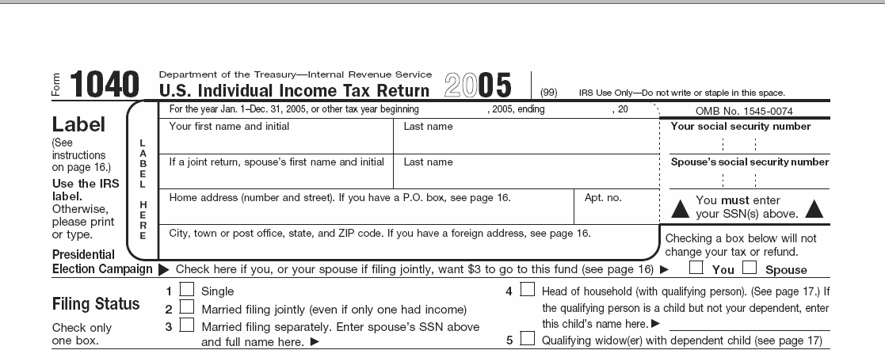
State & Federal Income Tax
Each American is subject to Federal Income Taxes.
Submitting U.S. Income Tax Return, like the 1040 form, will calculate the amount of taxes owed.
43 states have a State Income Tax and the rate varies in each state.
Utah has a flat tax rate on individual income of 5%.

Slide 18

Social Security
The Social Security tax is also called the FICA tax.
(Federal Insurance Contributions Act)

Slide 19

Social Security
Social Security taxes provide the following benefits for employees and their dependents:
• retirement benefits
• benefits for the dependents of retired workers
• benefits for the disabled and their dependents

Slide 20
Medicare
The Medicare tax is used to provide medical benefits for certain individuals when they reach age 65. Workers, retired workers, and the spouses of workers and retired workers are eligible to receive Medicare benefits upon reaching age 65.
(Remember that MediCARE helps those over 65 by thinking of CARING for the elderly)
Notes:
Irs.gov

Slide 21

Other Taxes
Property tax
Sales tax
Gasoline tax
Local/City taxes

Slide 22
What is our tax money used for?
  Bridges
  Road maintenance
  Research
  Education
  Armed services, national defense, veterans, and foreign affairs
  Retirement income for elderly
  Social programs
  Physical, human, and community development
  Law enforcement
  Interest on the national debt
Municipal Bonds: States, cities, counties, and towns issue bonds to pay for public projects (roads, building a new school, etc.) and finance other activities.

Slide 23

Tax Costs
To figure sales tax, purchased items are added together, then multiplied by the tax rate in decimal format. That total is then added to the subtotal for the final cost.
Figure the sales tax in the following scenarios.
If a CD costs $15.00 and the tax is 7.5%, what is the final cost?
Notes:
The Center for Applied Research in Education 1996
**Teacher explains that to figure sales tax, purchased items are added together, then multiplied by the tax rate in decimal format. That total is then added to the subtotal for the final cost.
$15.00 x .075 = $1.13 (round up)
$15.00 + $1.13 = $16.13

Slide 24
Tax Costs
You and your friends receive a lunch bill for $22.50 before tax is included. The tax in your state is 8%. What is the total cost when the tax is included?
Notes:
$22.50 X .08=$1.80
$22.50 + $1.80 = $24.30

Slide 25
Tax Costs
Which would cost more…a pair of earrings priced at $28.00 with a 7% tax, or a set of posters at $29.00 with a 5.5% tax?
Notes:
$28.00 x .07 = $1.96 $28.00 + $1.96 = $29.96 Earrings
$29.00 x .055 = $1.60 $29.00 + $1.60 = $30.60 Posters POSTERS COST MORE

Slide 26
Tax Costs
The class trip is going to cost each of the fifty students $130.00. If tax is 5%, what is the total cost for the entire class?
Notes:
$130.00 x 50 students = $6500
$6500 x .05 = $325
$6500 + $325 = $6825

Slide 27

Plan Ahead
Explain why it is critical to include tax when planning your budget and spending.
Notes:
Have students answer this alone on their worksheet, then discuss it as a class.

Slide 28
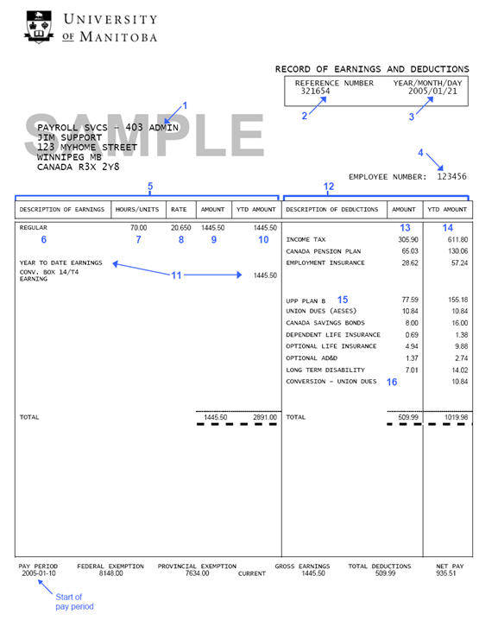
Pay Stub
Identifying information
1. The first line of the name and address block gives your internal mailing address
2. Payroll reference number. If you ever need to ask Payroll a question about your pay, quote the payroll reference number and your employee number
3. The pay date for the pay period.
4. Your employee number.
Earnings information
5. The earnings side of your pay stub.
6. “Regular” indicates your regular earnings from salary.
7. The number of hours paid with this type of earnings in this pay period.
8. The hourly rate for this type of earnings.
9. The amount paid for this type of earnings in this pay period.
10. The year-to-date amount paid for this type of earnings.
11. The amount you earned in 2005 before your payroll was processed.
Deduction information
12. The deductions side of your pay stub. The first deductions listed are the legislated deductions (Income Tax, Pension Plan, and Employment Insurance), followed by other deductions.
13. The amount deducted for this type of deduction in this pay period.
14. The year-to-date amount deducted for this type of deduction.
15. Name of Deductions.
16. Union dues paid in 2005 before your payroll was processed.
Notes:
Lesson Plan help http://practicalmoneyskills.com/english/pdf/teachers/specialneeds/lev_3/lesson_02/2_6overhead.pdf
Source: http://images.google.com/imgres?imgurl=http://umanitoba.ca/computing/projects/hris/images/pssupport1.jpg&imgrefurl=http://umanitoba.ca/computing/projects/hris/employees/63.htm&h=718&w=555&sz=51&hl=en&start=3&um=1&tbnid=2yqUPDYmC3xzTM:&tbnh=140&tbnw=108&prev=/images%3Fq%3Dhow%2Bto%2Bread%2Ba%2Bpay%2Bstub%26svnum%3D10%26um%3D1%26hl%3Den%26rlz%3D1T4GFRC_enUS217US218%26sa%3DN

Slide 29
Common Tax Forms
W-4
I-9
W-2
1040EZ
Utah State Tax Form

Slide 30
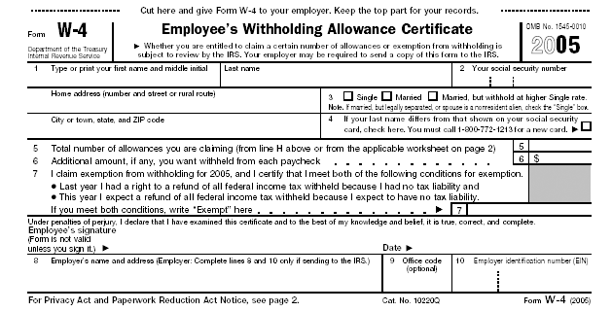
W4
You use W-4 Employee's Withholding Allowance Certificate Form to establish your withholding allowances for Federal income taxes. Fill out be(4) you start working.

Slide 31
W4
Fill out beFORE you begin working
Line 5 is where you write your withholding allowances.
Usually a number between 0 and 7.
Higher net pay but lower chance of tax return.
Lower net pay but greater chance of tax return.
Lower #
=
more $
withheld
Higher #
=
less $
withheld

Slide 32
I9
An I-9 Form is the Employment Eligibility Verification Form required by the Immigration and Naturalization Services (INS) to verify your identity and your eligibility to work.
All employees must complete this form and provide valid original identifications.
You are not eligible for pay until Payroll Services receives a satisfactory I-9.
Includes two forms of identify and/or eligibility.

Slide 33
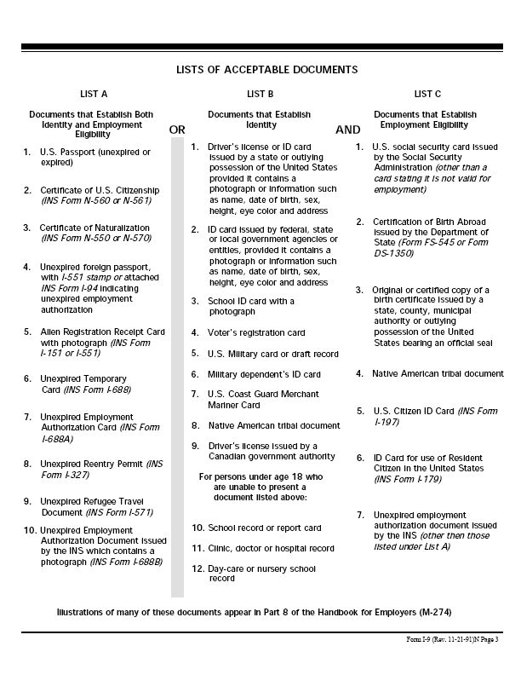
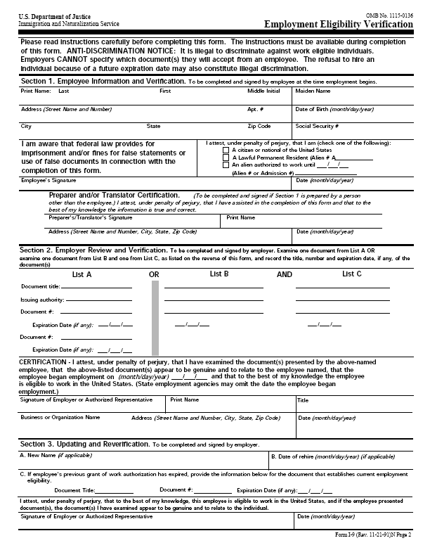
I-9

Slide 34
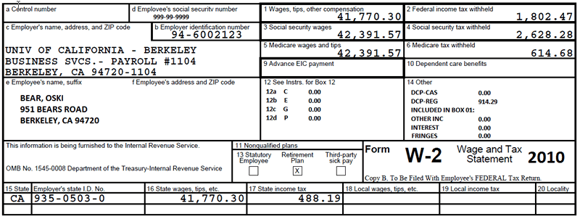
W-2
Reflects all taxable wages you received during the calendar year and all taxes withheld from those wages.
The form serves as an annual report that enables you to file your personal income tax return with the Internal Revenue Service.

Slide 35
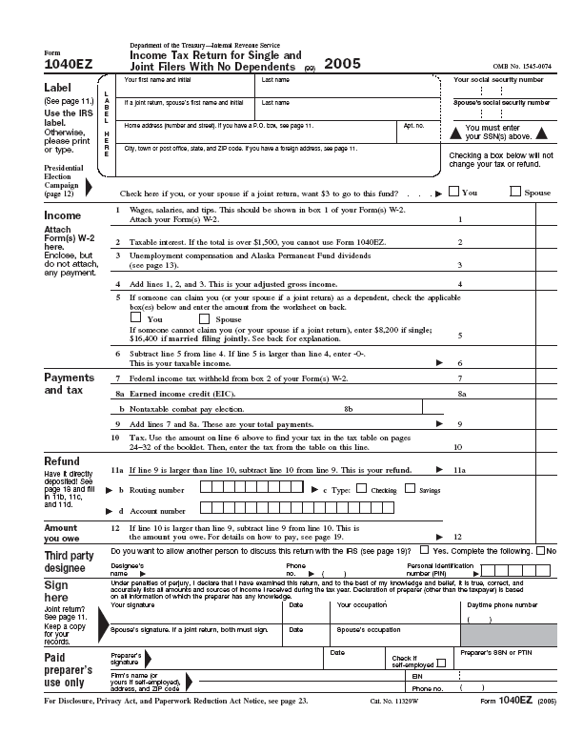
1040 EZ
Similar to the 1040 income tax form, 1040EZ is a faster and easier way to file your Federal Income Tax Return. This form is only eligible for people with income less than $50,000 and interest income of $400 or less.
Notes:
Printable from www.irs.gov

Slide 36

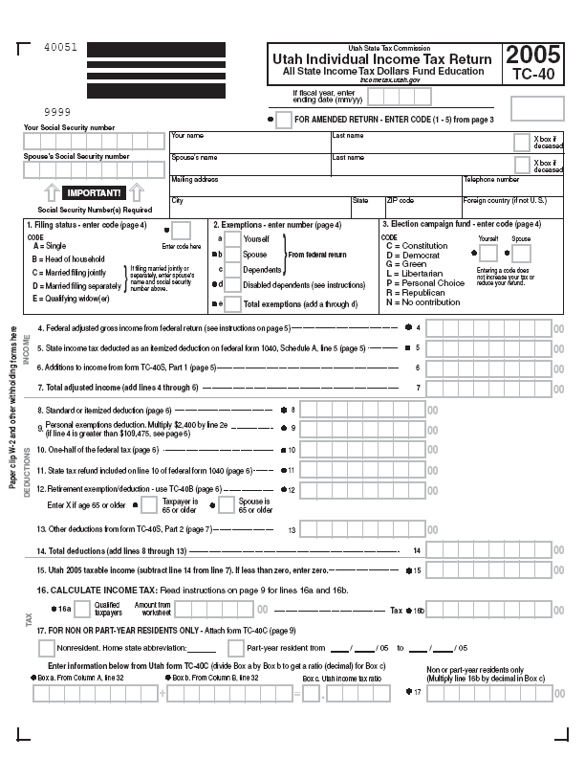
Utah State Tax
Form

Slide 37
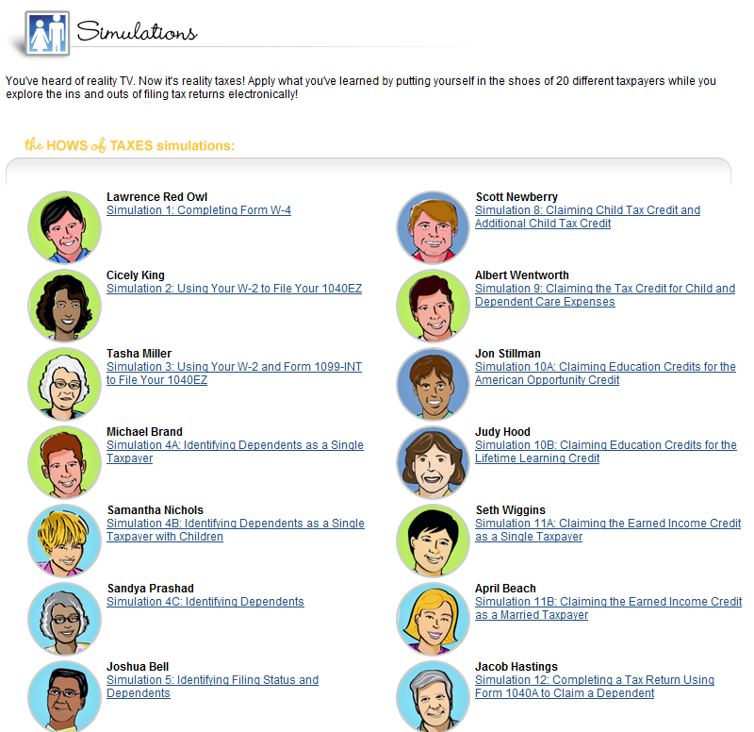
Tax Simulation
http://www.irs.gov/Individuals/Students
Choose UNDERSTANDING TAXES.
Choose the STUDENT SITE.
Click on SIMULATIONS.
Complete the simulations for: Lawrence Red Owl, Cicely King, & Monica Lindo

