Slide 1
Consumer Awareness & Privacy

Slide 2
Standard 3, Objective 4 Describe the rights and responsibilities of buyers and sellers under consumer protection laws.
Describe ways to avoid "Identity Theft" and fraud (e.g., keep Social Security numbers secure, properly dispose of outdated documents).
Explain the importance of understanding financial contracts (e.g., disclosure information, grace period, payment penalties, method of interest calculation).
List possible actions a consumer can take in response to excessive debt and collection practices (e.g., sell assets, negotiate a repayment schedule).
Describe ways to avoid financial scams and schemes designed to defraud consumers (e.g., Ponzi and pyramid schemes, affinity fraud).

Slide 3
why is privacy an important issue in the information age?

Slide 4
Public information
■ Demographic information (U.S. census)
■ Telephone directories
■ Birth, marriage, and divorce records
■ Voter registration records
■ Campaign contributions
■ Driver’s licenses/vehicle registrations
■ Licenses and permits (hunting, fishing, etc.)
■ Legal information (judgments, bankruptcies, real estate titles, etc.)

Slide 5
Info only accessed with a legitimate reason
■ Employment information
■ Credit reports
■ Tax information (IRS/state tax boards)
■ Criminal records
■ Social service records (welfare, Medicaid, etc.)
■ School records
■ Medical records

Slide 6
privacy act: requires each federal agency that maintains records to permit individuals to request
fair credit reporting act: gives consumers the right to dispute inaccurate information and permits them to insert their own version of disputed information into a credit report amendment of his or her record.

Slide 7
Privacy And Your Social Security Number
Now commonly used as a personal identifier
You can obtain a number at no charge. Everyone should have one
What Is It Used For?
Originally used to identify personal tax collection and Social Security benefit payment accounts.
Now also used for record-keeping purposes by many types of institutions, including:
financial institutions
universities
voter registration boards
credit bureaus
employers
government agencies.

Slide 8
What You Can Do:
Do not write Social Security number on personal checks.
Do not use as a password or PIN for ATM, building security, or other sensitive uses.
Do not provide your Social Security number unless required by a requester such as your employer, bank, etc.

Slide 9
Safety Tips for Shopping Online
Know the real deal
Look for clues about security
Use a credit card
Keep proof handy
Get the scoop on the seller

Slide 10
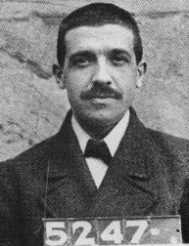
Common Frauds
a. Foreign Scams
b. Telemarketing Scams
c. Advance – Fee Loans
d. Credit Repairs
g. Magazine Subscriptions Scams
h. Toll – Free Scams
i. International Phone Scams
j. Prepaid Phone Card Scams
l. Ponzi Scheme
m. Pyramid Scheme
n. Affinity Fraud
http://saltlakecity.fbi.gov/multimedia/fraud052410/fraud052410.htm

Slide 11
Identity Theft
VIDEOS!

Slide 13
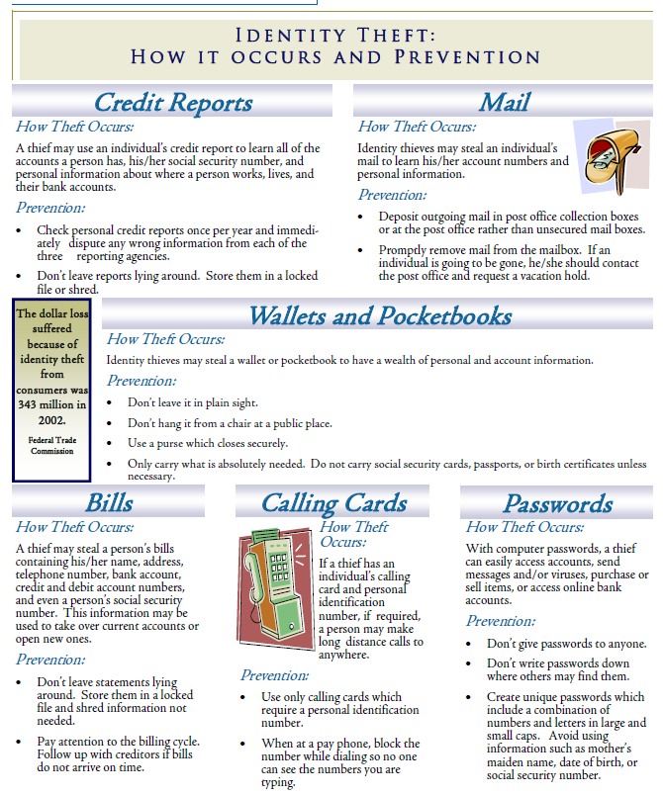

Slide 14
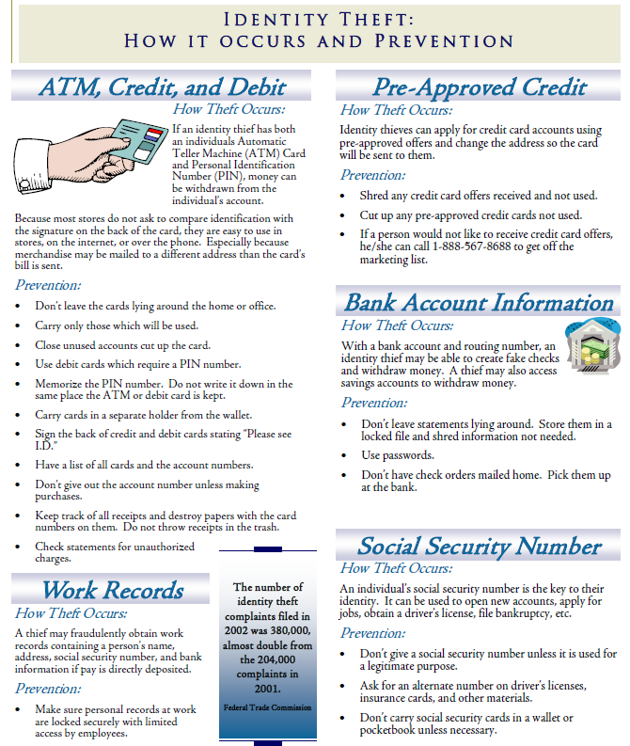

Slide 15
What to do if Identity Theft happens
No matter how careful a person may be, identity theft can happen. If a person believes he or she may be a victim, they
must follow these basic rules.
1. Act immediately.
2. Keep a detailed record of correspondence and phone records. These records should include the date, contact person, and any specific comments made or actions which will occur.
3. Contact the three major credit bureaus and request a “fraud alert” on file. Write a letter requesting no
new accounts are opened without written permission. In addition, request a credit report from each bureau. Carefully review the reports to ensure they are accurate.
4. Close all accounts which have been tampered with or opened fraudulently. When opening new accounts, use different passwords and pin numbers.
5. File a police report with the local police or in the local community where the theft took place.
6. File a complaint with the Federal Trade Commission at 1.877.ID.THEFT.

Slide 16
Agencies & Sources of Assistance
Food & Drug Administration (FDA) | www.fda.gov
Consumer Product Safety Commission (CPSC) | www.cpsc.gov
Federal Trade Commission (FTC) | www.ftc.gov
Better Business Bureau (BBB) | www.bbb.org
Bureau of Consumer Protection (BCP) | www.ftc.gov
Consumer Unions (Consumer Product-Testing Organizations) | Consumer Report Consumer Research Changing Times
Source: USOE Adult Roles & Responsibilities Curriculum

Slide 17
Debt & Collections
Collection Tips
Prioritize your bills
Don’t offer anything you can’t afford
Don’t tell them your life story
Stay calm and focused
Keep notes of the call
Get proof of pymt in writing
Negotiate at the end of the month

Slide 18
Contest Cons
a. What They Are
1. Promotions that use deceptively advertised prices
b. What To Watch For
1. Offers or notices announcing “fabulous” prizes
2. High – Pressure sales techniques
c. How To Avoid Being A Victim
1. Consider any purchases carefully before signing a contract
2. Don’t be deceived by letters that look official or urgent
3. Read the letter carefully
4. Think carefully before you attend a sales meeting
5. If you attend a sales meeting, don’t sign a contract or give a sales person a deposit right away
Work-At-Home Schemes
a. Common Schemes
1. Envelope Stuffing
2. Assembly or Craft Wok 3. Reading Books
b. To Avoid Being A Victim, Find Out
1. What task you will be required to perform
2. If you will be paid on salary or commission
3. Who will pay you
4. When will you get your first pay check
5. The total cost of the work- at-home program
6. The company’s reputation

Slide 19
why consumers don’t pay
loss of income (48%)
Unemployment (24%)
Illness (16%)
Other (divorce, death) (8%)
overextension (25%)
Poor money management
Emergencies
Materialism
Need for instant gratification
defective goods and services (20%)
fraudulent use of credit (4%)
other (3%)
Teens – Lesson 13 - Slide 13-A

Slide 20
warning signs of trouble
You don’t know how much you owe.
You often pay bills late.
You get a new loan to pay old loans.
You pay only the minimum balance due each month.
You spend more then 20% of your net income (after paying rent or mortgage) on debt maintenance.
You would have an immediate financial problem if you lost your job.
You’re spending more than you earn, using your savings to pay for day-to-day expenses.
Teens – Lesson 13 - Slide 13-B

Slide 21
first steps to take if you can’t pay your bills
take another (close) look at your budget
Trim your expenses.
Be realistic about what you can afford.
contact your creditors
Tell them why you can’t pay, that you intend to pay, and when/how much you will be able to pay.
You may be able to work out a new payment schedule.
If possible, continue to make the minimum payments.
Teens – Lesson 13 - Slide 13-C

Slide 22
wage garnishment
what is garnishment?
A legal procedure that withholds a portion of your earnings for the payment of debt.
the limits of garnishment
The lesser of 25% of your disposable income or 30 times the federal hourly minimum wage.
You may be able to get a “Claim of Exemption.”
claim of exemption (only if you meet all of the following conditions)
Your family is living in the state.
All the money you earn is needed to provide necessities.
Debt was for a necessity (food, housing, medical care).
Garnishment has already been started.
what protection you have
You cannot be fired for any one garnishment.
how the law is enforced
Enforced by the Secretary of Labor through the Wage and Hour Division of the U.S. Department of Labor.
Teens – Lesson 13 - Slide 13-H

Slide 23
straight bankruptcy
duration on your credit record
Up to 10 years
what you may still owe
Taxes
Child support
Alimony
College loans
Fines
Illegal debts
Co-signer obligations
what you no longer owe
Retail store charges
Bank credit card charges
Unsecured loans
Unpaid hospital or physician bills
Teens – Lesson 13 - Slide 13-L

Slide 25
