Slide 1
Computers Are Your Future Chapter 1
Computer Technology

Slide 2
Invention and Progression of Computers
1937 First Electronic Digital Computer
1943 Eniac
1951 UNIVAC 1—First Commercial
Computer

Slide 3
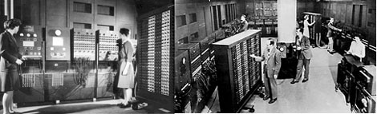
The physical size of this machine is enormous compared to the computers we have today. According to Wikipedia the ENIAC “contained 17,468 vacuum tubes, 7,200 crystal diodes, 1,500 relays, 70,000 resistors, 10,000 capacitors and around 5 million hand-soldered joints. It weighed 30 short tons (27 t), was roughly 8.5 feet by 3 feet by 80 feet (2.6 m by 0.9 m by 26 m), took up 680 square feet (63 m²), and consumed 150 kW of power. Input was possible from an IBM card reader, while an IBM card punch was used for output.”

Slide 4
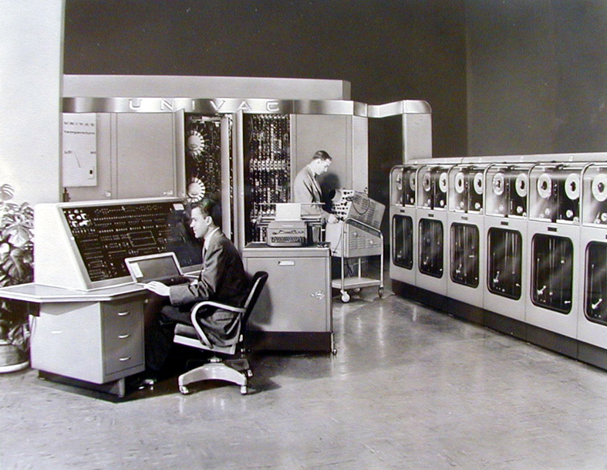

Slide 5


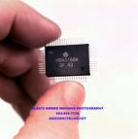
1958 Jack Kilby of Texas Instruments invents
integrated circuits

Slide 6
Computers Get Faster and Smaller
1969 ARAPNET—Predecessor of the Internet
1975 First LAN
1976 First Apple Computer
1980 Bill Gates creates DOS
1981 IBM PC Introduced

Slide 7
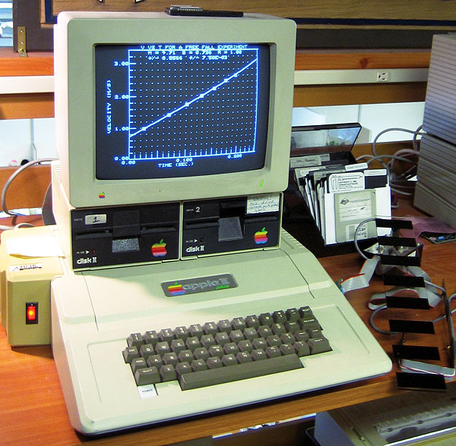
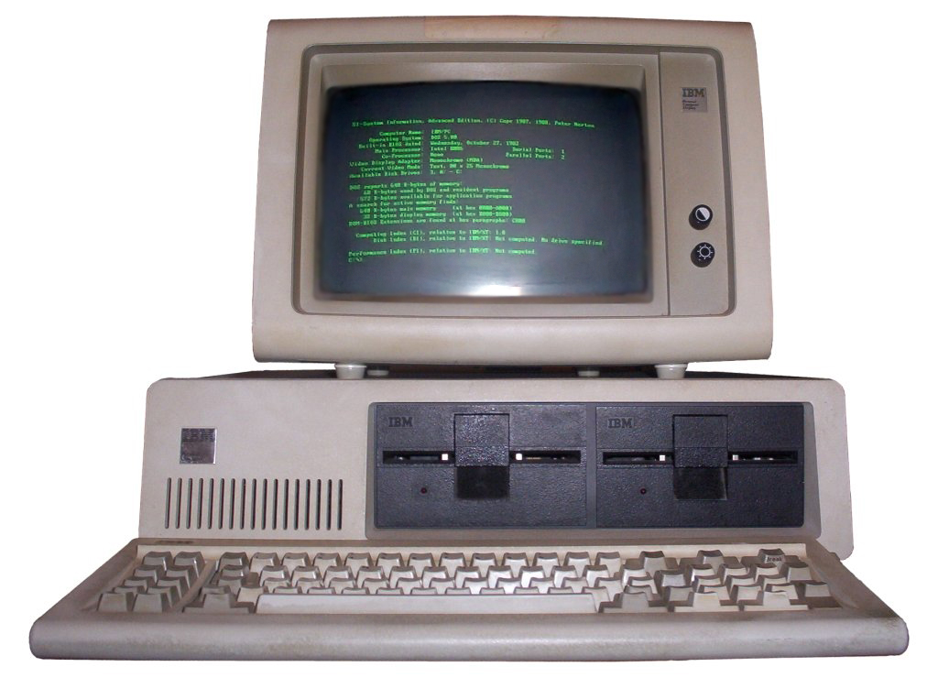

Slide 8
Computers Get More User Friendly and More People Use Them
1991 World Wide Web (August 6)
1992 Windows 3.1 is introduced
1997 DVD technology is invented
2001 25 million users subscribe to AOL
Internet service
2001 Internet Explorer
2003 MySpace
2006 Facebook (available to the general public)
2007 iPhone
2009 Internet Statistics
2010 iPad - Tablets

Slide 9
Computers for Home and Personal Use
Affordable, small units that can be used at home OR at work.

Slide 10
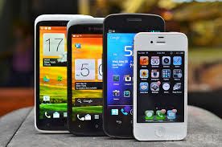
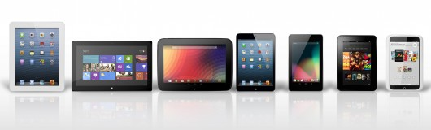
Handheld Devices
SmartPhones
Tablets
Average Price - $99 - $800

Slide 11
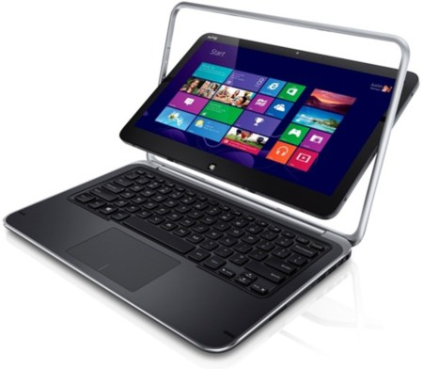
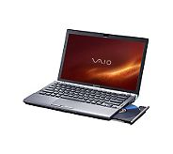
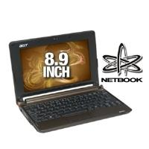
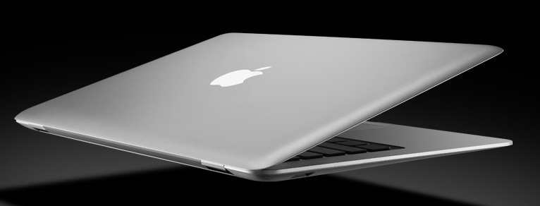
Notebooks, Etc.
Portable
Cost $300 - $2,500

Slide 12
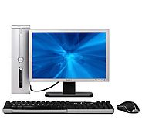
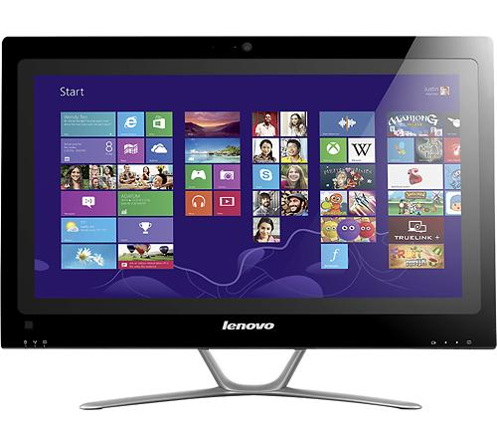
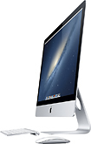
Desktop
Also Called
  Micro Computer
  PC
Cost: $250 - $2,500

Slide 13
Computers for Business
Used in addition to or in conjunction with PCs, laptops, palms, etc.

Slide 14
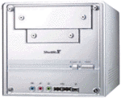
Mini Computer
Sometimes used as a server for a small – medium sized network.
Cost: $10,000 and up

Slide 15
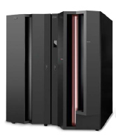
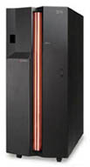
Mainframe
Used as a server for medium to large businesses or organizations.
Cost: $100,000 and up

Slide 16
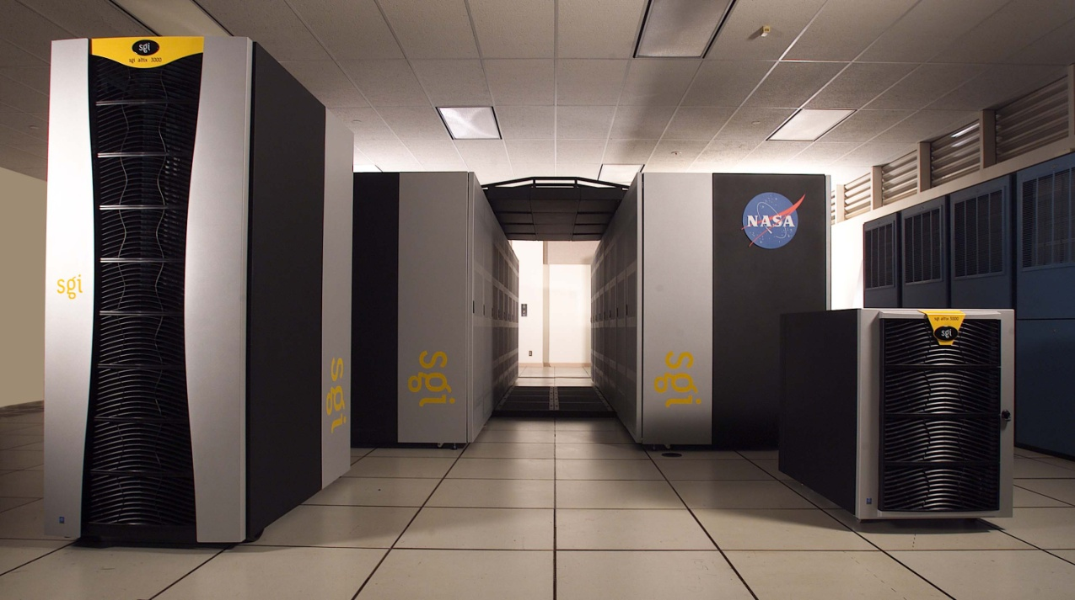
Supercomputer
Largest, most powerful computers used today
  NASA
  Large Universities
  Government
Cost: $ Millions
Supercomputer Top 500

Slide 17
Computer
Input
Processing
Output
Storage
A computer is a machine that performs four basic operations:

Slide 18
Computer System
A collection of related components that have been designed to work together.
Hardware
Software
Computer
System

